Slide 1
Bairns’ Hoose Anniversary Event 24 October 2024

Slide 2
Welcome
Aberdeen – by Peter Scroggie

Slide 3
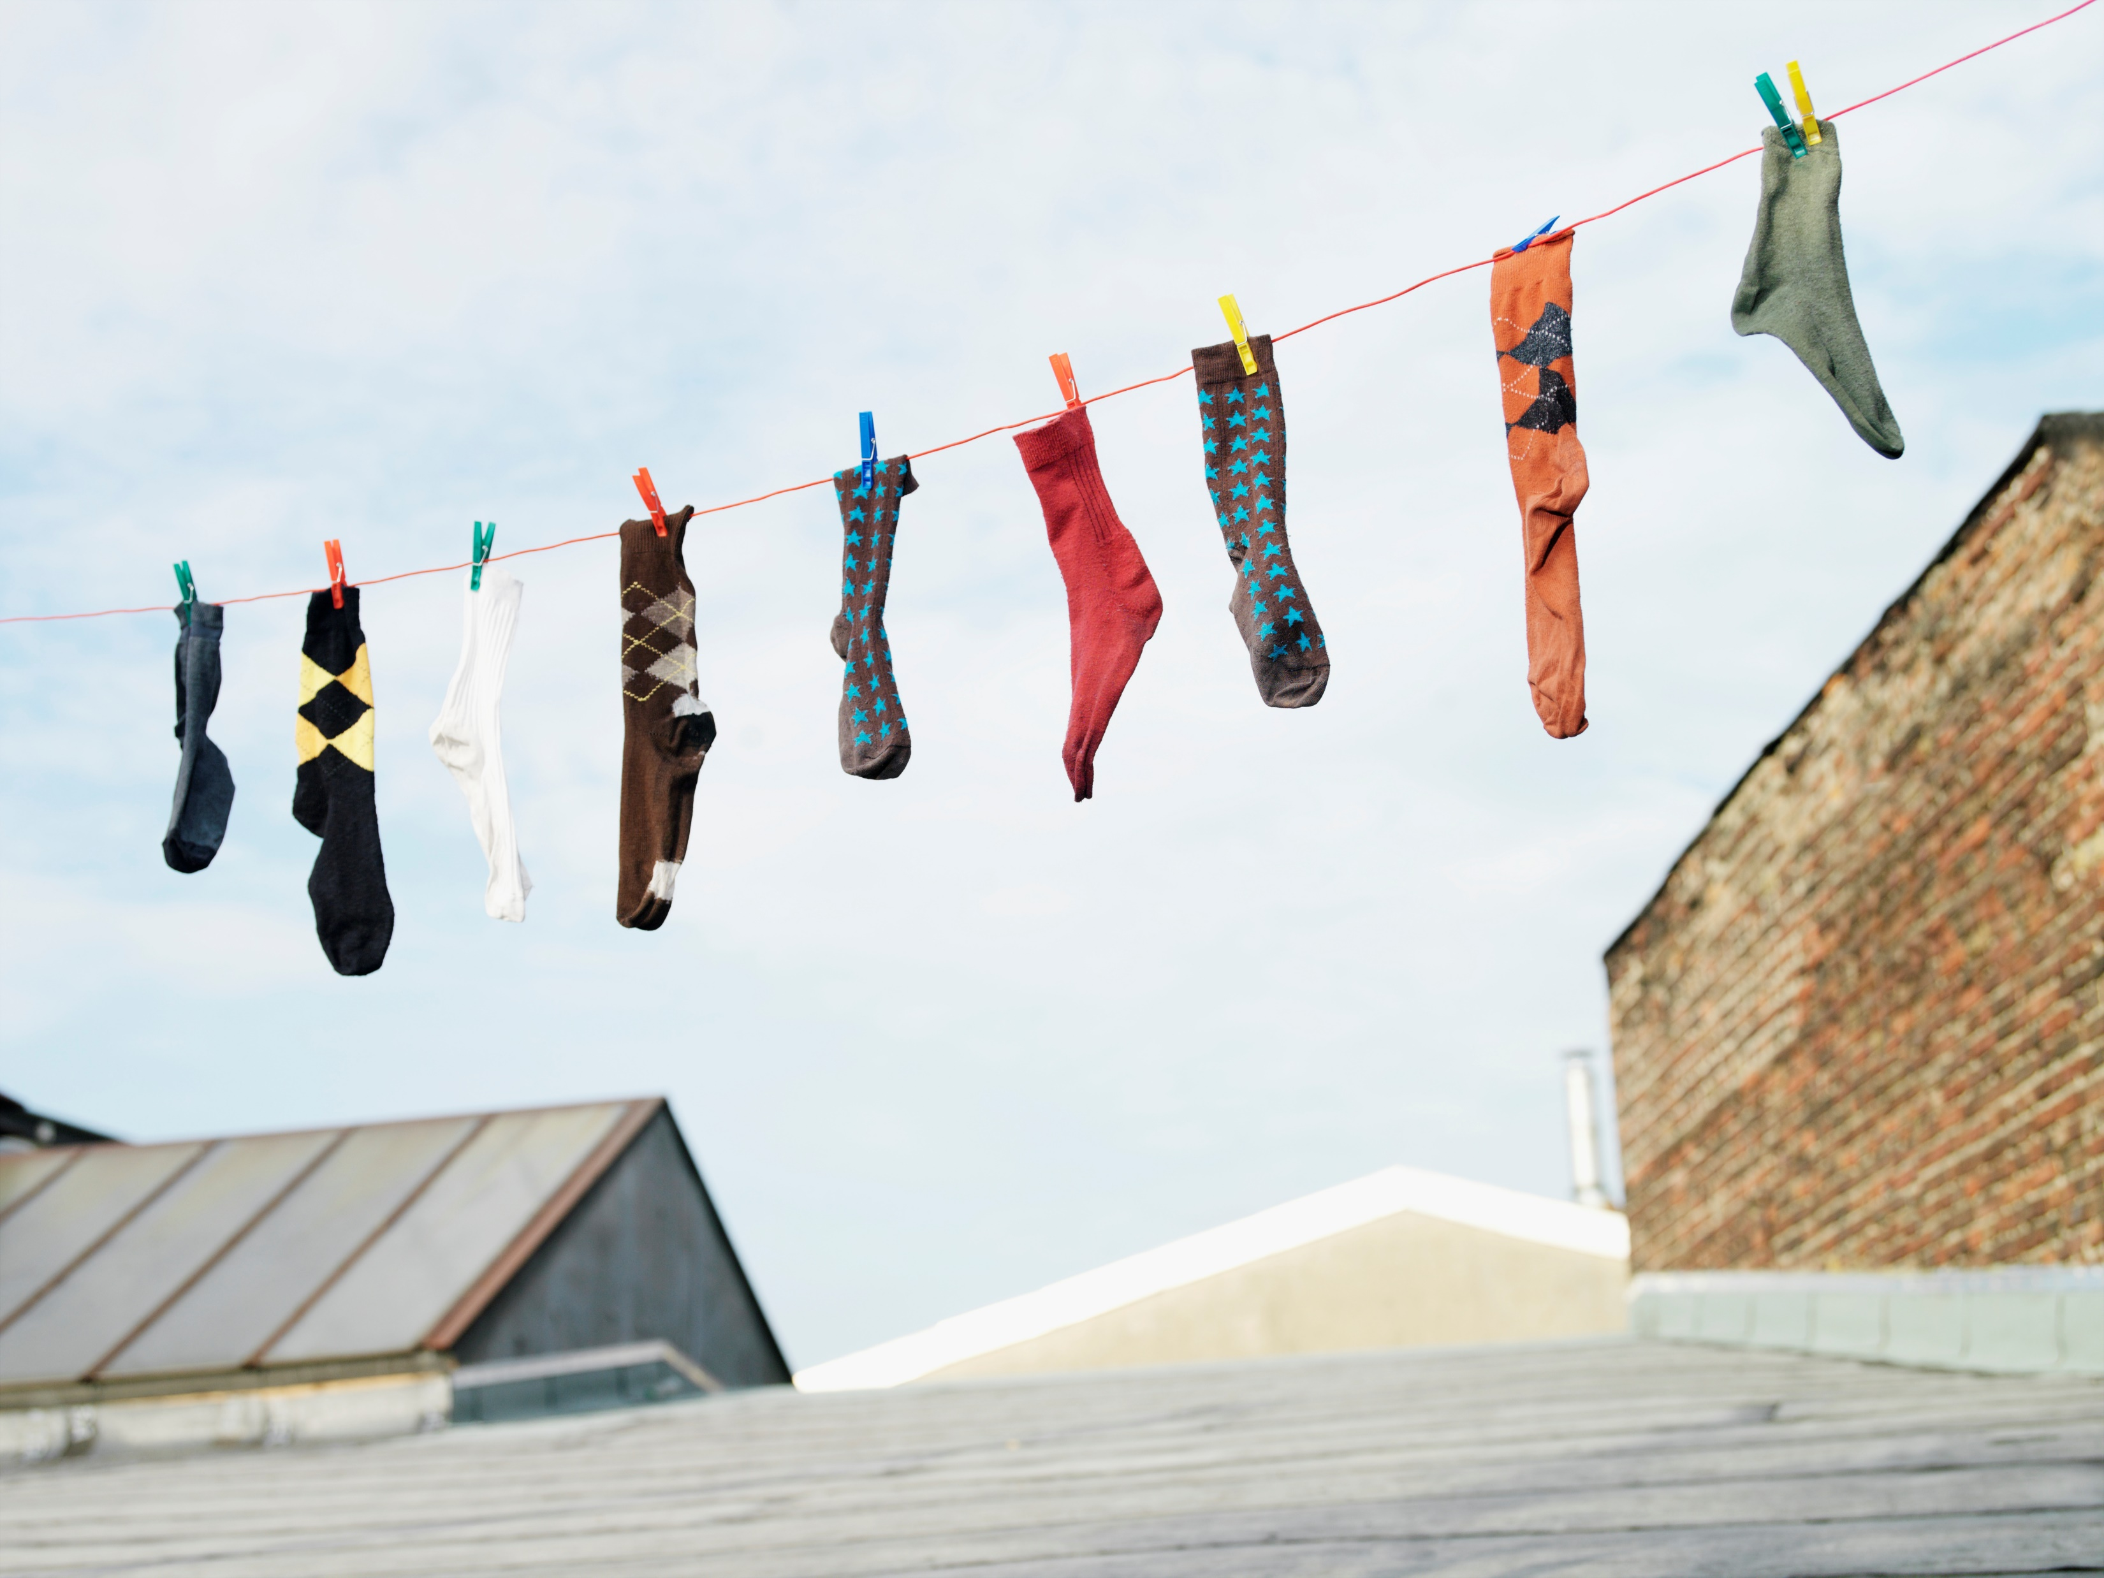
Housekeeping

Slide 4
Today’s purpose
To celebrate and reflect on the first year of the Pathfinder phase
Hear about each other’s work, share learning and develop ideas
Continue to build connections
Creative, inspired and motivated
Continued commitment of Scottish Government

Slide 5
Agenda
Agenda
10.45 | Welcome
10.55 | Keynote: Ms Don-Innes, Minister for Children, Young People and The Promise
11.05 | Connections across partnerships
11.20 | Reflections on the progress in Scotland
12.10 | Learning session – Pathfinder Breakouts
13.20 | Lunch and networking
14.15 | Video: Ms Todd, Minister for Social Care, Mental Wellbeing and Sport
14.25 | Programme and analytical update
15.00 | Break
15.15 | Expert panel
16.00 | Reflections and close (16.30)
16.30 | Networking

Slide 6
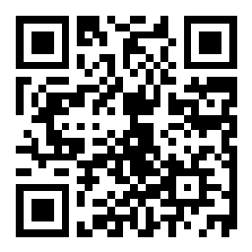
Questions for the expert panel
Go to slido.com and type in #4103702

Slide 7
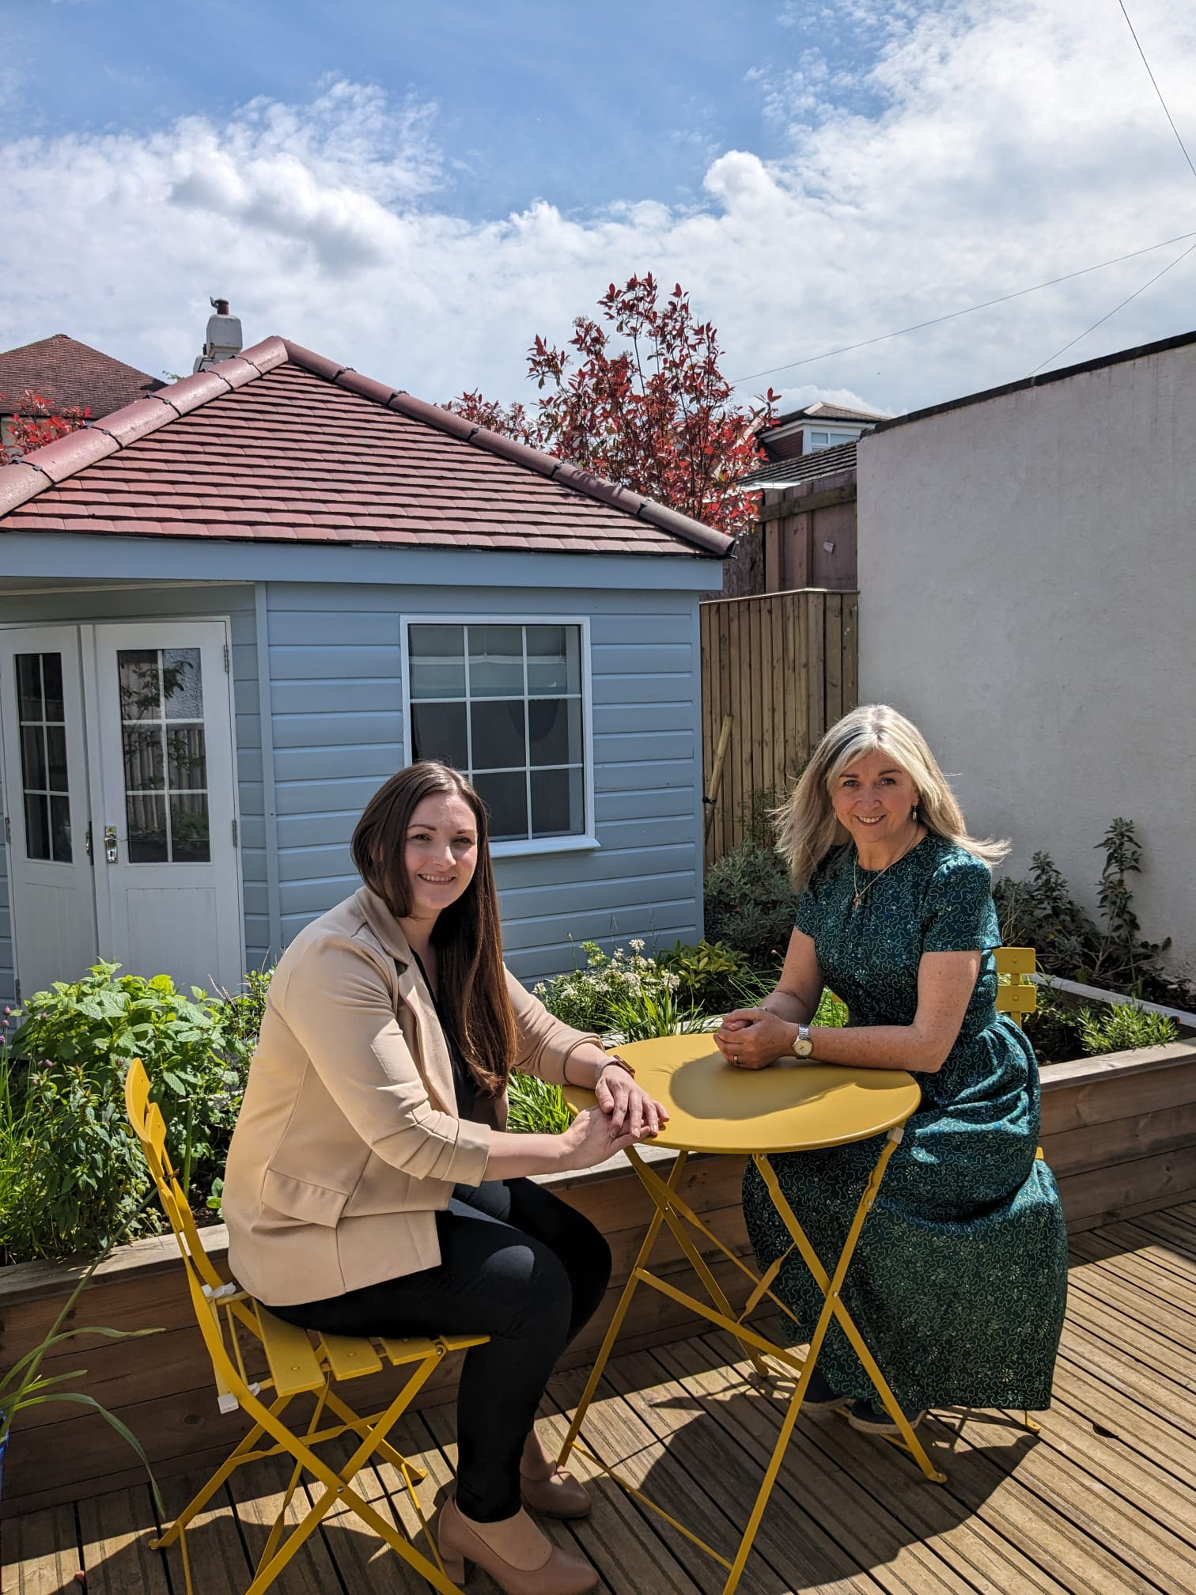
Ms Don-Innes
Minister for Children, Young People and The Promise

Slide 9
Making connections

Slide 10
Fireside discussion

Slide 11
Pathfinder learning breakouts
6 Break out groups each led by a Pathfinder.
Each round of is 25-30 minutes
Round 1: 15 mins for Pathfinders to set out their journey so far (good, bad and ugly); 10/15 minute discussion
Round 2: repeat

Slide 12
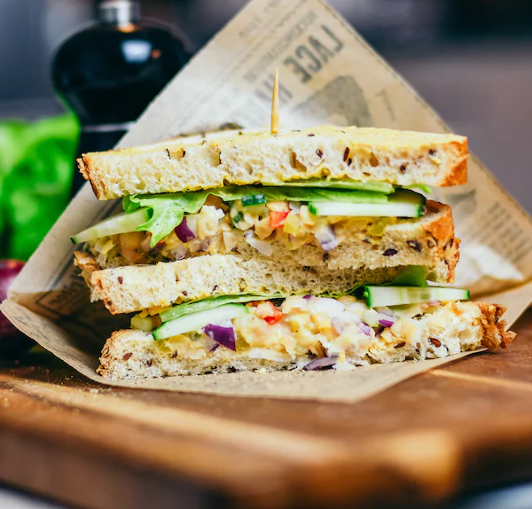
Thank you and lunch

Slide 13
Ms Todd
Minister for Social Care, Mental Wellbeing and Sport

Slide 14
Video Ms Todd

Slide 15
Bairns’ Hoose Programme Update William Kløverød Griffiths, Scottish Government

Slide 16
Approach to Bairns’ Hoose
Scottish Government Programme for Government 2024-25 commitment
“Test our approach to Bairns’ Hoose across ten areas – providing safe, trauma-informed environments for child
victims and witnesses to access multi-agency support and recovery services – ahead of a national rollout, incrementally, from 2027.”

Slide 17
Bairns’ Hoose Pathfinder phase
To have enough knowledge about how the Standards work in different contexts to develop a national Bairns’ Hoose blueprint which will underpin the next phase (incremental rollout)

Slide 18
National Bairns’ Hoose Workstreams
Analysis – indicators development, StART tool analysis, etc.
Knowledge Exchange – webinars, events, etc.
Quality improvement and service design
Engagement with children and young people
Funding

Slide 19
Bairns’ Hoose programme – timelines
23 | 2024 |  |  |  | 2025 |  |  |  | 2026 |  |  |  | 2027 |  |  |  | 2028 |  |  |  | 2029 |  |  |  | 2030
Oct-Dec | Jan-Mar | Apr-June | Jul-Sep | Oct-Dec | Jan-Mar | Apr-June | Jul-Sep | Oct-Dec | Jan-Mar | Apr-June | Jul-Sep | Oct-Dec | Jan-Mar | Apr-June | Jul-Sep | Oct-Dec | Jan-Mar | Apr-June | Jul-Sep | Oct-Dec | Jan-Mar | Apr-June | Jul-Sep | Oct-Dec | Jan-Mar | Apr-June | Jul-Sep | Oct-Dec
Timelines
Initial Path-finder phase
Year 1 Pathfinder Phase
Year 2 Pathfinder Phase
Year 3 Pathfinder Phase
Incremental Rollout
Analysis
Analysis
Blueprint scoping
Blueprint development
Incremental Rollout evaluation scoping
Incremental Rollout evaluation

Slide 20
Bairns’ Hoose Standards Fiona Wardell, HIS

Slide 21
The National Bairns’ Hoose Standards
Developed from 2019 and published in May 2023
Evidence-informed, based on international methodology with 25 years' experience in independent, high-quality standards development
Outline a nationally consistent Bairns' Hoose in Scotland
The Pathfinders are testing the application of the Standards in different contexts
The Standards are a framework which partnerships can use to see and measure their progress towards full implementation of Bairns' Hoose

Slide 22
Standards Self-Assessment and Readiness Tool Dafni Dima, Scottish Government

Slide 23
Pathfinder phase
The aims of the Pathfinder partnerships are to
trial and test the Bairns’ Hoose Standards within their own contexts
learn what works in what context
identify challenges
and produce knowledge about the methods, practices and resources required for implementation

Slide 24
Analysis workstream
Literature review of existing international research and guidance
Analysis of the Standards Self-Assessment and Readiness Tool (StART) and funding reports
Qualitative research with key professionals from Pathfinders
Collaborative development of a core indicator set on Bairns’ Hoose across Scotland
Final research report

Slide 25
StART - Overview
Standards Self-Assessment and Readiness Tool
Draws upon the Bairns’ Hoose Standards
Developed jointly by Healthcare Improvement Scotland (HIS) and Care Inspectorate in 2023

Slide 26
StART - Purpose
Partnerships to self-assess their progress in implementing the Standards
Partnerships to use as an improvement tool
Overall picture of progress against the Standards
Test Standards and their implementation across different contexts of Scotland
Compare implementation at start and end of Pathfinder phase

Slide 27
StART - Use
Pathfinders have been asked to complete the tool twice:
February 2024 – start of Pathfinders phase
August 2025 – close to the end of the phase
analysis
Final research report
Recommendations

Slide 28
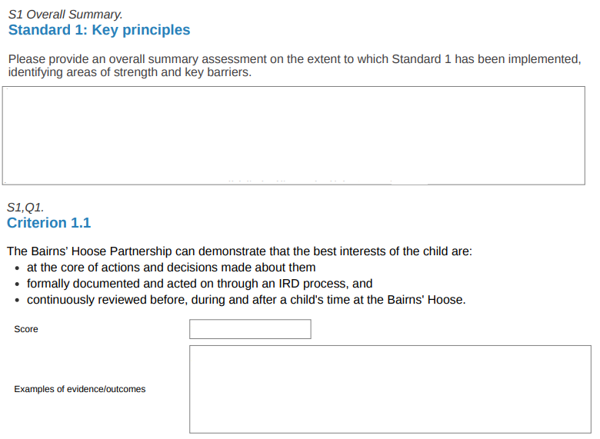
Completion of StART
Information, examples, score
Rating | Guidance
6 | Full achievement: All elements addressed and no gaps in meeting the standard (100%)
5 | Very good achievement: Majority of the elements addressed (70-85%)
4 | Good achievement: Most of the elements addressed (more than 60-70%)
3 | Satisfactory achievement: (50%- 60%)
2 | Fair achievement: Some of the elements addressed (between 30 - 50%)
1 | Poor achievement: Few or none of the elements addressed (under 30%)
Notes:
What is the starting position of Pathfinders in terms of Local context (in terms of organisational structures and collaboration; local workforce; geographical area; practicalities of BH locations) AND Implementation of Standards
What are Pathfinders priorities/key actions to be taken forward during the Pathfinder phase?
How have they been developed?
How are they related to the local context?
Have these changed over the duration of the Pathfinder phase? How?
What are the priority outcomes for the actions identified?
What is the position of Pathfinders at the end of the Pathfinder phase, in terms of: Implementation of the planned activities; Achievement of the Standards; Identified outcomes, including outcomes for children and young people.
What learning can be identified for the pilot phase in terms of: Core essential components of the BH approach AND Best practice in different contexts.

Slide 29
StART Analysis - Findings Marianiki Vlachou, CYCJ

Slide 30
Standard 1: Key Principles
Achievements
Challenges
Multi-agency collaboration, oversight and governance
Kindness, empathy and respect
Best interests of the child
The right to be heard
Initiatives to ensure accessibility
Child-friendly communication
Integrated planning, coordination & data collation
Meeting the practical needs of children & families
Managing multiple interests

Slide 31
Standard 2: Collaborative Leadership & Governance
Achievements
Challenges
Commitment to collaborate
Emerging structures, systems & processes
Foundations of participation
Learning culture
Integrated planning and strategy
Development of the participation approach
Resourcing & staffing
Guidance needed

Slide 32
Standard 3: Inclusive Access
Achievements
Challenges
Use of existing guidelines
Use of existing data to identify needs
Supporting travel needs
Support for families
Accessibility
Serving remote communities
Ensuring effective communication access
Communication needs

Slide 33
Standard 4: Design & Environment
Achievements
Challenges
Private and accessible locations
Co-design with children & families
Building a one-roof model
Follow up on children’s voice

Slide 34
Standard 5: Planning for Children
Achievements
Challenges
Established good practice embedded
Multi-agency collaboration
Considered use of physical space
Data management & information sharing
Children’s views are heard
Need for integrated processes
More resources and staff needed

Slide 35
Standard 6: Interviews
Achievements
Challenges
Utilisation of existing systems and processes
Child-friendly environment
Trained staff
Primary and secondary analysis of information
Children receive verbal information
Staffing
Supporting children with communication needs
Lack of soundproof places
Accessible literature for children

Slide 36
Standard 7: Support through Court & Legal Processes
Achievements
Challenges
Remote court attendance
Interagency collaboration
Government guidance

Slide 37
Standard 8: Health & Wellbeing
Achievements
Challenges
Engagement with health
Child-friendly information
Integration and referral to existing services
Trained professionals
Trauma-informed approach
Lack of physical space, resources & infrastructure
Coordination in health support
Limited-service availability
Guidance needed
Need to strengthen participation

Slide 38
Standard 9: Therapeutic Recovery Services
Achievements
Challenges
Solid foundations
Collaboration & external partnerships
Gaps in service provision & resources
Harmonisation of therapeutic support

Slide 39
Standard 10: Multidisciplinary Staff Training & Support
Achievements
Challenges
Commitment from partners
Evolving community of practice
Supervision in place
Strong training basis to start from
Joint workforce planning needed
Need for national guidance
Lack of time & resources

Slide 40
Standard 11: Prevention, Sharing Knowledge and Learning from Good Practice
Achievements
Challenges
Use of existing core data sets
Effective monitoring systems
Children and families are part of evaluation process
Local learning feeding into national policy and practice
Raising awareness of children’s experiences of abuse or neglect
Bairns’ Hoose coordinator
Integrating service design feedback into the development of practice.
Raising awareness while maintaining anonymity.
Protected staff time for training and development.
Bairns' Hoose core data set.

Slide 41
To sum up
Commitment & Professionalism
Strong Foundations
Collaboration & Integration
Localised Focus
A Whole Journey Approach
Strengths
Participation
Inclusion and Accessibility
Health & Wellbeing
Justice System Readiness
Staff & Resourcing
Areas for development

Slide 42
Thank you!

Slide 43
Coffee Break
Go to slido.com and type in #4103702

Slide 44
Expert panel
Dr Mary Mitchell, Senior Lecturer in Social Work, University of Edinburgh
Laura Buchan, Procurator Fiscal, Policy and Engagement, Crown Office and Procurator Fiscal Service
Fiona Wardell, Team Lead for the Standards and Indicators Team, Healthcare Improvement Scotland
Mary Glasgow, Chief Executive, Children 1st
Bragi Guðbrandsson, founder of the Barnahus model and vice chair of the United Nations Committee on the Rights of the Child

Slide 45
25/10 Crowd sourcing

Slide 46
Bold ideas

Slide 47
Instructions for the exercise
Mill and pass – don’t read. Everyone has one card at all times
Pair up and read – exchange thoughts
Score 1 – 5 – on the back of your card
1 = waste of ink; 5 = genius
Score
A few rounds …see which idea gets the highest score

Slide 48
Feedback

Slide 49
Thank you – safe journey home

Slide 50
Join us for crudities with dips before you catch your train

